Slide 1


Acquisition, Wrangling and Cleaning
07
PART II · FROM DATA TO INSIGHT
CHAPTER 7 · WEEK 4
Data Science — From Foundations to Intelligent Systems
LECTURER
Dr. Mustafa Hameed
THE ISLAMIA UNIVERSITY OF BAHAWALPUR
Bahawalpur, Pakistan
Department of Information Technology · BSIT · Fall 2026
Notes:
Chapter 7: Acquisition, Wrangling and Cleaning. Part 2 — From Data to Insight. Week 4: Wrangling and cleaning. Handout pages 43–48.

Slide 2

Where this chapter sits
THE COURSE
PART I
PART II
PART III
PART IV
PART V
PART VI
1
2
3
4
5
6
7
8
9
10
11
12
13
14
15
16
17
18
19
20
21
22
23
24
25
26
27
28
29
30
31
32
Acquisition, Wrangling and Cleaning
BUILDS ON
USED LATER IN
Ch 2 The Data Science Lifecycle
Ch 8 Exploratory Data Analysis and Visualisation
Ch 3 Data: Types, Sources and Quality
Ch 11 Machine Learning Fundamentals
Ch 23 Data Engineering at Scale
Data Science · Chapter 7 · Acquisition, Wrangling and Cleaning
Handout p. 43 2
Notes:
Place the chapter. Before you start: Chapter 3 (types, scales, quality dimensions, missingness mechanisms) and Chapter 2 (framing question 4, on what is knowable at prediction time).

Slide 3

What you will be able to do
LEARNING OUTCOMES
By the end of this chapter you will be able to:
1
Select an appropriate acquisition method and describe the risks each carries.
2
Perform the standard cleaning operations: deduplication, type repair, missing-value handling and outlier treatment.
3
Choose between join types and predict how each changes the row count.
4
Encode categorical variables and scale numeric ones without corrupting the measurement scale.
5
Detect and prevent data leakage — the most expensive routine error in applied machine learning.
Data Science · Chapter 7 · Acquisition, Wrangling and Cleaning
Handout p. 43 3
Notes:
Read these out: they are the chapter's contract with the room. Each click adds one.

Slide 4

Vocabulary for this chapter
KEY TERMS
ETL / ELT
API
web scraping
deduplication
imputation
join (inner, left, outer)
one-hot encoding
ordinal encoding
normalisation
standardisation
binning
data leakage
pipeline
Each term is defined where it first matters — not here.
Data Science · Chapter 7 · Acquisition, Wrangling and Cleaning
Handout p. 43 4
Notes:
Do not define these now; they arrive one at a time. This slide is for the students' notes. Terms: ETL / ELT; API; web scraping; deduplication; imputation; join (inner, left, outer); one-hot encoding; ordinal encoding; normalisation; standardisation; binning; data leakage; pipeline.

Slide 5

In this chapter
IN THIS CHAPTER
7.1
Where Data Comes From
p. 43 ›
7.2
The Cleaning Sequence
p. 44 ›
7.3
Joining Data
p. 45 ›
7.4
Encoding and Scaling
p. 45 ›
7.5
Data Leakage
p. 46 ›
Data Science · Chapter 7 · Acquisition, Wrangling and Cleaning
Handout pp. 43–48 5
Notes:
The route through the chapter. Each row is a link: click it to jump to that section in the slide show.

Slide 6
Where Data Comes From
SECTION 1 OF 5
7.1
7.1 Where Data Comes From
7.2 The Cleaning Sequence
7.3 Joining Data
7.4 Encoding and Scaling
7.5 Data Leakage
Data Science · Chapter 7
Handout §7.1 6
Notes:
Pause. Name the question this section answers.

Slide 7

Where Data Comes From
AT A GLANCE
Source | Typical use | The risk you must manage
Database query | Internal transactional systems | The production database is not a playground; a careless join can lock tables
File export (CSV, Excel) | One-off extracts, shared datasets | Silent type coercion — Excel turns identifiers into dates and drops leading zeros
REST API | SaaS platforms, VLE data, threat feeds | Rate limits, pagination, and schemas that change without notice
Streaming (MQTT, Kafka) | IoT telemetry, live logs | Out-of-order and duplicate delivery; see Chapter 23
Web scraping | Public pages with no API | Legal and ethical limits, brittle selectors, and terms of service
Manual entry / survey | Ground truth, labels, context | Human error, missingness that is rarely MCAR
Data Science · Chapter 7 · Acquisition, Wrangling and Cleaning
§7.1 · Handout p. 43 7
Notes:
Do not read the table row by row: pick the row the room is most likely to get wrong and ask why.

Slide 8

Before You Acquire Anything
WATCH OUT
Ask two questions that are not technical: am I permitted to use this data for this purpose, and does it contain personal data. Answering them after building the model is how projects get cancelled at the last stage. Chapter 28 covers the substance; the point here is that acquisition is the moment to ask.
Data Science · Chapter 7 · Acquisition, Wrangling and Cleaning
§7.1 · Handout p. 43 8
Notes:
Read the box aloud, then ask for an example from the room before moving on.

Slide 9
The Cleaning Sequence
SECTION 2 OF 5
7.2
7.1 Where Data Comes From
7.2 The Cleaning Sequence
7.3 Joining Data
7.4 Encoding and Scaling
7.5 Data Leakage
Data Science · Chapter 7
Handout §7.2 9
Notes:
Pause. Name the question this section answers.

Slide 10
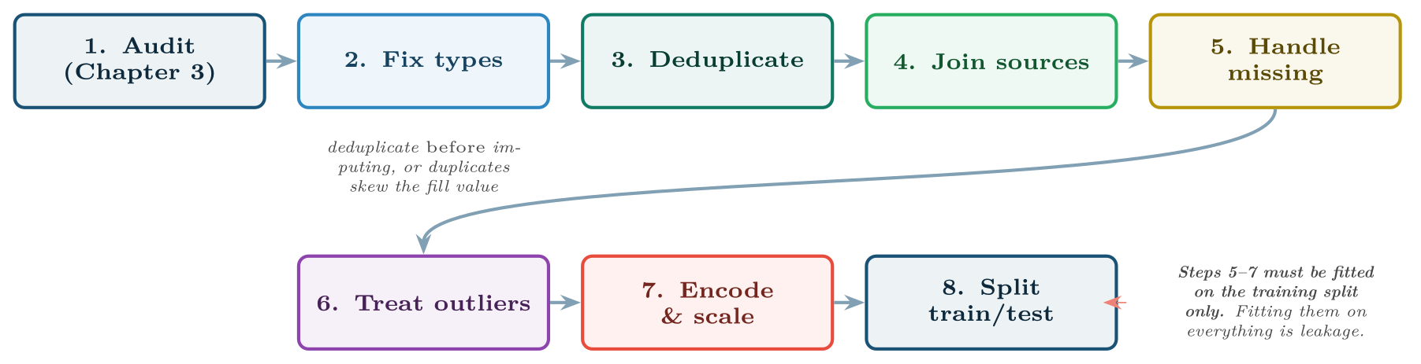
The cleaning sequence
FIGURE 7.1
The order is not arbitrary: each step assumes the previous one is done. The note on the right is the single most important rule in the chapter and is expanded in 7.5.
Data Science · Chapter 7 · Acquisition, Wrangling and Cleaning
§7.2 · Handout p. 44 10
Notes:
Order matters. Doing these in the wrong sequence causes quiet corruption — for example, imputing before deduplicating lets duplicated rows vote twice on the mean you impute with.
Figure 7.1 (handout p. 44): The cleaning sequence. The order is not arbitrary: each step assumes the previous one is done. The note on the right is the single most important rule in the chapter and is expanded in 7.5.

Slide 11
Handling Missing Values
AT A GLANCE
Strategy | How | When it is appropriate
Drop rows | Remove any row with a missing value | Missingness is MCAR and rare (<5%). Otherwise you are deleting a biased subset
Drop column | Remove the feature entirely | More than roughly half missing and no reason to think absence is informative
Mean / median fill | Replace with the column’s centre | Numeric, MCAR or MAR, and the variable is not central to the model
Forward fill | Carry the last observation forward | Time series with slow-changing values — sensor telemetry especially
Model-based | Predict the missing value from other columns | Valuable feature, MAR, enough data to justify the complexity
Missing indicator | Add a boolean was_missing column | MNAR — the absence itself carries signal. Usually combined with a simple fill
Data Science · Chapter 7 · Acquisition, Wrangling and Cleaning
§7.2.1 · Handout p. 44 11
Notes:
Do not read the table row by row: pick the row the room is most likely to get wrong and ask why.

Slide 12

The Default You Should Adopt
CONCEPT
When unsure, add the missing indicator and fill with the median. It costs one column, never destroys information, and lets the model decide whether absence matters. In learning analytics and security logging this is almost always the right call, because absence is rarely accidental (Chapter 3).
Data Science · Chapter 7 · Acquisition, Wrangling and Cleaning
§7.2.1 · Handout p. 44 12
Notes:
Read the box aloud, then ask for an example from the room before moving on.

Slide 13
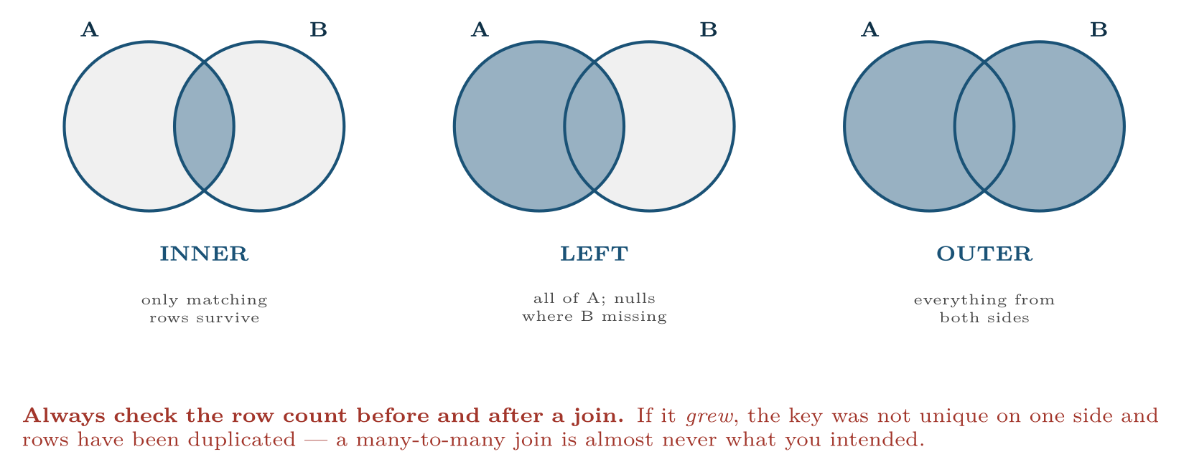
The three joins you will use
FIGURE 7.2
The default in most tools is inner, which silently discards non-matching rows; if 300 of your 2,000 students have no VLE record, an inner join removes them and your sample is no longer the cohort.
Data Science · Chapter 7 · Acquisition, Wrangling and Cleaning
§7.3 · Handout p. 45 13
Notes:
Real projects always need more than one table. The join type decides how many rows survive, and choosing wrongly is a common source of silently wrong analyses.
Figure 7.2 (handout p. 45): The three joins you will use. The default in most tools is inner, which silently discards non-matching rows; if 300 of your 2,000 students have no VLE record, an inner join removes them and your sample is no longer the cohort.

Slide 14
Encoding and Scaling
SECTION 4 OF 5
7.4
7.1 Where Data Comes From
7.2 The Cleaning Sequence
7.3 Joining Data
7.4 Encoding and Scaling
7.5 Data Leakage
Data Science · Chapter 7
Handout §7.4 14
Notes:
Pause. Name the question this section answers.

Slide 15

One-Hot vs. Ordinal Encoding
DEFINITION
One-hot encoding turns a nominal variable with k categories into k binary columns, preserving the fact that no order exists. Ordinal encoding maps categories to integers, and is correct only when the categories genuinely have an order (low < medium < high).
Data Science · Chapter 7 · Acquisition, Wrangling and Cleaning
§7.4 · Handout p. 45 15
Notes:
Read the box aloud, then ask for an example from the room before moving on.

Slide 16
Normalisation vs. Standardisation
DEFINITION
Data Science · Chapter 7 · Acquisition, Wrangling and Cleaning
§7.4 · Handout p. 45 16
Notes:
Read the box aloud, then ask for an example from the room before moving on.

Slide 17

Scaling the Student Vectors
WORKED EXAMPLE
From Chapter 4: a = [92, 8, 12], b = [45, 3, 0], with plausible ranges attendance [0,100], quizzes [0,10], posts [0,25].
Unscaled distance: √(47² + 5² + 12²) = √(2378) ≈ 48.8, of which attendance contributed 93%.
Min–max normalised:
a′ = [0.92, 0.80, 0.48], b′ = [0.45, 0.30, 0.00].
Scaled distance: √(0.47² + 0.50² + 0.48²) = √(0.2209 + 0.25 + 0.2304) = √(0.7013) ≈ 0.837.
Contribution now: attendance 31%, quizzes 36%, posts 33% — roughly equal, which is what “these three features matter comparably” actually means. Note this is a modelling decision, not a correction: you have declared the three features equally important. If attendance really is more important, say so with a weight, deliberately.
Data Science · Chapter 7 · Acquisition, Wrangling and Cleaning
§7.4 · Handout p. 45 17
Notes:
Each click adds one step of the working. Ask for the next number before you reveal it.

Slide 18
Encoding and Scaling
AT A GLANCE
Method needs scaling? | Because | Examples
Yes — essential | Uses distances or gradients | k-NN, k-means, SVM, PCA, neural networks, ridge/lasso
No — indifferent | Splits on one feature at a time, so units are irrelevant | Decision trees, random forests, gradient boosting
Data Science · Chapter 7 · Acquisition, Wrangling and Cleaning
§7.4 · Handout p. 45 18
Notes:
Do not read the table row by row: pick the row the room is most likely to get wrong and ask why.

Slide 19
Data Leakage
SECTION 5 OF 5
7.5
7.1 Where Data Comes From
7.2 The Cleaning Sequence
7.3 Joining Data
7.4 Encoding and Scaling
7.5 Data Leakage
Data Science · Chapter 7
Handout §7.5 19
Notes:
Pause. Name the question this section answers.

Slide 20
Data Leakage
DEFINITION
Leakage occurs when information that would not be available at prediction time influences training. The model scores brilliantly in testing and fails in production, because it learned to use a fact from the future.
Data Science · Chapter 7 · Acquisition, Wrangling and Cleaning
§7.5 · Handout p. 46 20
Notes:
Read the box aloud, then ask for an example from the room before moving on.

Slide 21
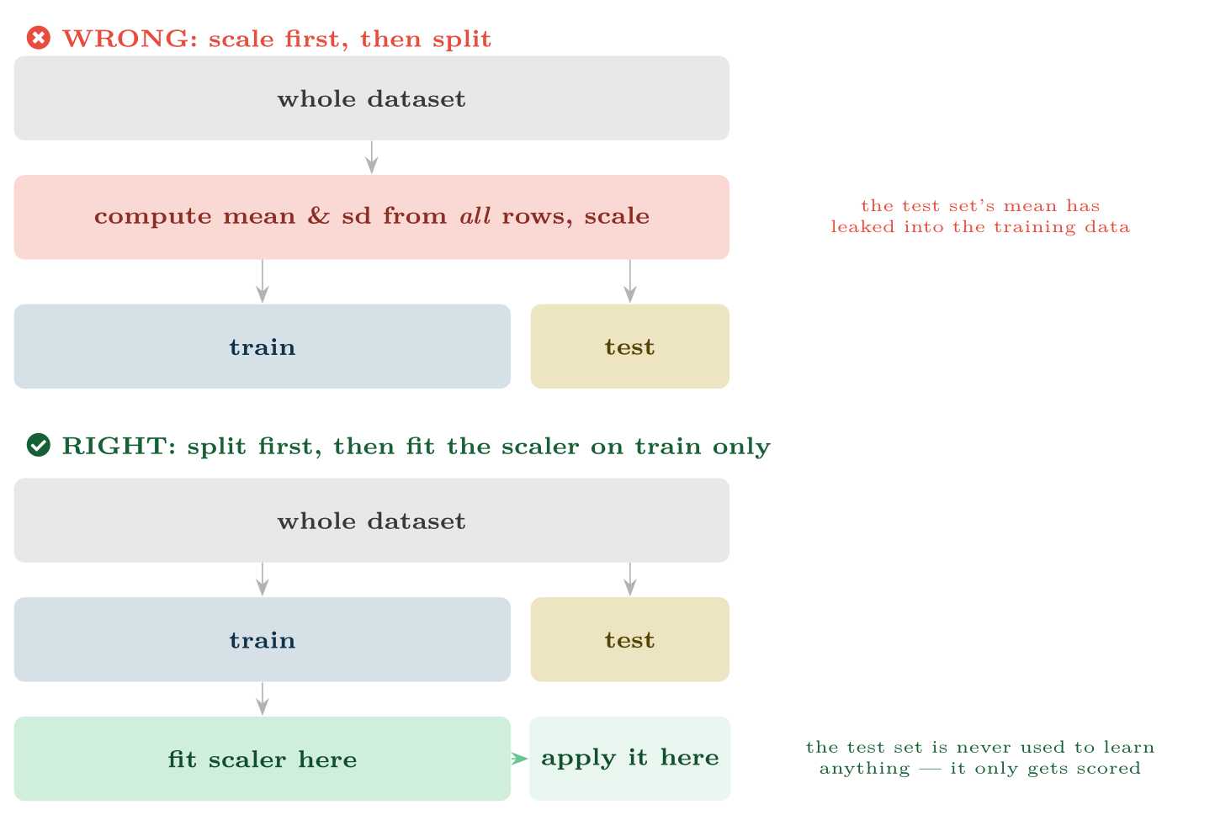
The most common leakage in student projects
FIGURE 7.3
Any transformation that learns something from the data — scaling, imputation, encoding, feature selection — must be fitted on the training split alone and then applied to the test split.
Data Science · Chapter 7 · Acquisition, Wrangling and Cleaning
§7.5 · Handout p. 46 21
Notes:
Figure 7.3 (handout p. 46): The most common leakage in student projects. Any transformation that learns something from the data — scaling, imputation, encoding, feature selection — must be fitted on the training split alone and then applied to the test split.

Slide 22

Five Leaks and How to Spot Them
COMMON PITFALLS
The universal warning sign: a model that is far more accurate than the problem plausibly allows. If your dropout classifier reaches 99%, look for a leak before celebrating.
✕
Fitting a scaler or imputer on the full dataset. Fix: fit on train, transform test. Use a Pipeline so it is impossible to forget.
✕
A feature computed after the outcome. final_attendance to predict failure; ticket_close_time to predict overrun. Fix: framing question 4.
✕
Random splitting of time-series data. Training on Thursday to predict Wednesday. Fix: split chronologically (Chapter 19).
✕
Duplicate rows spanning the split. The same student in both train and test through a merge error. Fix: split by entity, not by row.
✕
Feature selection on the whole dataset. Choosing the top 20 correlated features before splitting has already consulted the test set.
Data Science · Chapter 7 · Acquisition, Wrangling and Cleaning
§7.5 · Handout p. 46 22
Notes:
For each pitfall, ask who has seen it happen. One real story beats five bullets.

Slide 23





Four lenses: Cleaning and Leakage
FOUR LENSES
LEARNING ANALYTICS
PROJECT MANAGEMENT
Joining registry to VLE data is a left join from registry, never an inner join — students with no VLE activity are precisely the at-risk group, and an inner join deletes them.
Effort figures are self-reported and cluster on round numbers, so treat values as ordinal-ish rather than precise.
INTERNET OF THINGS
CYBERSECURITY
Forward fill is the natural imputation for telemetry, because a temperature that was 70° a second ago is probably still about 70° — but cap how far it carries, or a dead sensor will appear healthy for hours.
Do not remove outliers — they are the attacks.
Data Science · Chapter 7 · Acquisition, Wrangling and Cleaning
Handout p. 48 23
Notes:
The same method, four domains. Each of the next four slides opens one lens in full.

Slide 24

Learning Analytics: Cleaning and Leakage
FOUR LENSES
LEARNING ANALYTICS
Project Management
Joining registry to VLE data is a left join from registry, never an inner join — students with no VLE activity are precisely the at-risk group, and an inner join deletes them. Classic leak: using total_submissions_in_semester to predict a week-4 outcome. Missing engagement data should be encoded with an indicator, not imputed, because it is MNAR.
Internet of Things
Cybersecurity
Data Science · Chapter 7 · Acquisition, Wrangling and Cleaning
Handout p. 48 24
Notes:
Learning Analytics. Joining registry to VLE data is a left join from registry, never an inner join — students with no VLE activity are precisely the at-risk group, and an inner join deletes them. Classic leak: using total_submissions_in_semester to predict a week-4 outcome. Missing engagement data should be encoded with an indicator, not imputed, because it is MNAR.

Slide 25

Project Management: Cleaning and Leakage
FOUR LENSES
PROJECT MANAGEMENT
Learning Analytics
Effort figures are self-reported and cluster on round numbers, so treat values as ordinal-ish rather than precise. Classic leak: including actual_completion_date or final story-point count when predicting mid-sprint completion. Deduplicate carefully — the same work item often appears under two IDs after a project is re-scoped.
Internet of Things
Cybersecurity
Data Science · Chapter 7 · Acquisition, Wrangling and Cleaning
Handout p. 48 25
Notes:
Project Management. Effort figures are self-reported and cluster on round numbers, so treat values as ordinal-ish rather than precise. Classic leak: including actual_completion_date or final story-point count when predicting mid-sprint completion. Deduplicate carefully — the same work item often appears under two IDs after a project is re-scoped.

Slide 26

Internet of Things: Cleaning and Leakage
FOUR LENSES
INTERNET OF THINGS
Learning Analytics
Forward fill is the natural imputation for telemetry, because a temperature that was 70° a second ago is probably still about 70° — but cap how far it carries, or a dead sensor will appear healthy for hours. Classic leak: normalising the whole telemetry history including the future. Deduplicate on (device ID, timestamp): at-least-once delivery guarantees duplicates.
Project Management
Cybersecurity
Data Science · Chapter 7 · Acquisition, Wrangling and Cleaning
Handout p. 48 26
Notes:
Internet of Things. Forward fill is the natural imputation for telemetry, because a temperature that was 70° a second ago is probably still about 70° — but cap how far it carries, or a dead sensor will appear healthy for hours. Classic leak: normalising the whole telemetry history including the future. Deduplicate on (device ID, timestamp): at-least-once delivery guarantees duplicates.

Slide 27

Cybersecurity: Cleaning and Leakage
FOUR LENSES
CYBERSECURITY
Learning Analytics
Do not remove outliers — they are the attacks. Encode categorical fields such as protocol and port with one-hot, never ordinal, or the model will infer that port 443 is “greater than” port 80. Classic leak: features derived from the incident report, which by definition exists only after the attack was detected. Split chronologically, since a model trained on future attack patterns to detect past ones proves nothing.
Project Management
Internet of Things
Data Science · Chapter 7 · Acquisition, Wrangling and Cleaning
Handout p. 48 27
Notes:
Cybersecurity. Do not remove outliers — they are the attacks. Encode categorical fields such as protocol and port with one-hot, never ordinal, or the model will infer that port 443 is “greater than” port 80. Classic leak: features derived from the incident report, which by definition exists only after the attack was detected. Split chronologically, since a model trained on future attack patterns to detect past ones proves nothing.

Slide 28

Try it yourself: A Leak-Proof Cleaning Pipeline
TRY IT YOURSELF
The single best habit in applied machine learning: put every learned transformation inside a Pipeline, so it cannot be fitted on the test set by accident.
THIS WEEK'S LAB
WHAT YOU WILL RUN
Week 4: Leak-proof pipeline
1 listing, 30 lines of Python
Data Science · Chapter 7 · Acquisition, Wrangling and Cleaning
§7.5 · Handout p. 46 28
Notes:
The single best habit in applied machine learning: put every learned transformation inside a Pipeline, so it cannot be fitted on the test set by accident.

Slide 29
A Leak-Proof Cleaning Pipeline
LAB · STEP 1 OF 2
Set-up
Python
1
2
3
4
5
6
7
8
9
10
11
12
13
14
15
16
import pandas as pd
from sklearn.model_selection import train_test_split
from sklearn.pipeline import Pipeline
from sklearn.compose import ColumnTransformer
from sklearn.impute import SimpleImputer
from sklearn.preprocessing import StandardScaler, OneHotEncoder
df = pd.read_csv("students.csv")
y = df.pop("failed")
numeric = ["attendance_pct", "quizzes_done", "forum_posts"]
categorical = ["programme", "entry_route"]
# 1. SPLIT FIRST -- before anything is learned from the data.
X_tr, X_te, y_tr, y_te = train_test_split(
df, y, test_size=0.2, stratify=y, random_state=42)
Data Science · Chapter 7 · Acquisition, Wrangling and Cleaning
§7.5 · Handout p. 46 29
Notes:
Step 1: Set-up. Read the code aloud; ask what each line would print before running it.

Slide 30
A Leak-Proof Cleaning Pipeline
LAB · STEP 2 OF 2
Python
17
18
19
20
21
22
23
24
25
26
27
28
29
# 2. Declare transformations; nothing is fitted yet.
prep = ColumnTransformer([
("num", Pipeline([("impute", SimpleImputer(strategy="median",
add_indicator=True)), # MNAR-safe
("scale", StandardScaler())]), numeric),
("cat", OneHotEncoder(handle_unknown="ignore"), categorical),
])
# 3. fit_transform on TRAIN, transform only on TEST.
X_tr_ready = prep.fit_transform(X_tr)
X_te_ready = prep.transform(X_te) # <- .transform, never .fit_transform
print(X_tr.shape, "->", X_tr_ready.shape) # wider: one-hot + indicators
Data Science · Chapter 7 · Acquisition, Wrangling and Cleaning
§7.5 · Handout p. 46 30
Notes:
Read the code aloud; ask what each line would print before running it.

Slide 31
What the lab shows
TRY IT YOURSELF
Check your understanding: what goes wrong if line 3’s last call is changed to fit_transform? Name the leak and the symptom you would see.
Data Science · Chapter 7 · Acquisition, Wrangling and Cleaning
§7.5 · Handout p. 46 31
Notes:
Read the box aloud, then ask for an example from the room before moving on.

Slide 32

You join 2,000 student rows to a VLE table and get 2,380 rows back. What has happened, and what should you check?
CHECKPOINT 1 OF 3
Discuss with the person next to you, then advance.
Data Science · Chapter 7 · Acquisition, Wrangling and Cleaning
Handout p. 48 · answers in Appendix D 32
Notes:
Ask the room. Do not advance until someone commits to an answer.

Slide 33

You join 2,000 student rows to a VLE table and get 2,380 rows back. What has happened, and what should you check?
CHECKPOINT 1 OF 3 · ANSWER
The join key was not unique on the VLE side, so rows were duplicated — probably multiple VLE accounts or enrolments per student. Check for duplicates on the key, decide the intended grain, and aggregate before joining.
Data Science · Chapter 7 · Acquisition, Wrangling and Cleaning
Handout p. 48 · answers in Appendix D 33
Notes:
Answer (Appendix D): The join key was not unique on the VLE side, so rows were duplicated — probably multiple VLE accounts or enrolments per student. Check for duplicates on the key, decide the intended grain, and aggregate before joining.

Slide 34
Which of these need scaling before use: k-NN, random forest, k-means, gradient boosting?
CHECKPOINT 2 OF 3
Discuss with the person next to you, then advance.
Data Science · Chapter 7 · Acquisition, Wrangling and Cleaning
Handout p. 48 · answers in Appendix D 34
Notes:
Ask the room. Do not advance until someone commits to an answer.

Slide 35
Which of these need scaling before use: k-NN, random forest, k-means, gradient boosting?
CHECKPOINT 2 OF 3 · ANSWER
k-NN and k-means require scaling (both are distance-based). Random forest and gradient boosting do not — they split one feature at a time, so units are irrelevant.
Data Science · Chapter 7 · Acquisition, Wrangling and Cleaning
Handout p. 48 · answers in Appendix D 35
Notes:
Answer (Appendix D): k-NN and k-means require scaling (both are distance-based). Random forest and gradient boosting do not — they split one feature at a time, so units are irrelevant.

Slide 36
A model predicting 30-day equipment failure achieves 99.8% accuracy on held-out data. State the first three things you would check.
CHECKPOINT 3 OF 3
Discuss with the person next to you, then advance.
Data Science · Chapter 7 · Acquisition, Wrangling and Cleaning
Handout p. 48 · answers in Appendix D 36
Notes:
Ask the room. Do not advance until someone commits to an answer.

Slide 37
A model predicting 30-day equipment failure achieves 99.8% accuracy on held-out data. State the first three things you would check.
CHECKPOINT 3 OF 3 · ANSWER
(i) leakage from a feature computed after or during the failure window; (ii) duplicate rows spanning the train/test split, or splitting by row rather than by device; (iii) whether the test period is genuinely later in time than the training period.
Data Science · Chapter 7 · Acquisition, Wrangling and Cleaning
Handout p. 48 · answers in Appendix D 37
Notes:
Answer (Appendix D): (i) leakage from a feature computed after or during the failure window; (ii) duplicate rows spanning the train/test split, or splitting by row rather than by device; (iii) whether the test period is genuinely later in time than the training period.

Slide 38

What to take away
CHAPTER SUMMARY
1
Acquisition method determines the failure modes you inherit; check permission and personal-data status before building.
2
Clean in order: audit, types, deduplicate, join, missing, outliers, encode and scale, split.
3
Under MNAR, add a missing indicator rather than imputing away the signal.
4
Inner joins silently delete non-matching rows; always compare row counts before and after.
5
One-hot for nominal, ordinal encoding only for genuinely ordered categories. Scale for distance- and gradient-based methods; trees do not care.
6
Leakage is the defining error of the field. Split first, fit transformations on train only, and treat implausibly good results as a symptom rather than a success.
Data Science · Chapter 7 · Acquisition, Wrangling and Cleaning
Handout p. 48 38
Notes:
Ask the room to say each takeaway before you reveal it.

Slide 39

Quick check 1 of 2
REVIEW · MULTIPLE CHOICE
Which method is indifferent to feature scaling?
A
k-nearest neighbours
B
k-means
C
random forest
D
support vector machine
Data Science · Chapter 7 · Acquisition, Wrangling and Cleaning
Handout p. 48 39
Notes:
Take a show of hands for each option before discussing. (The handout does not print MCQ answers.)

Slide 40
Quick check 2 of 2
REVIEW · MULTIPLE CHOICE
Fitting a StandardScaler on the full dataset before splitting causes:
A
underfitting
B
leakage
C
class imbalance
D
multicollinearity
Data Science · Chapter 7 · Acquisition, Wrangling and Cleaning
Handout p. 48 40
Notes:
Take a show of hands for each option before discussing. (The handout does not print MCQ answers.)

Slide 41
For your notebook
REVIEW QUESTIONS
SHORT
Explain when ordinal encoding is correct and give an example where using it would be a serious error.
SHORT
Why must forward fill be capped when imputing sensor telemetry?
SHORT
Describe two situations in which an inner join produces a biased dataset without producing any error message.
APPLIED
You must predict, at the end of week 4, which students will fail. From this list, mark each feature usable or leaking and justify: weeks1_4_attendance, final_exam_mark, n_submissions_by_week4, total_semester_logins, entry_qualification, withdrew_date.
APPLIED
Write the cleaning sequence you would apply to an IoT dataset of 400 motors reporting every 10 seconds for a year, stating for each step the specific decision you would take and why.
Data Science · Chapter 7 · Acquisition, Wrangling and Cleaning
Handout p. 48 41
Notes:
Set these for independent study. Model answers are not printed in the handout.

Slide 42
End of Chapter 7
07
NEXT
READ
Chapter 8 — Exploratory Data Analysis and Visualisation
Handout Chapter 7, pages 43–48
THIS WEEK'S LAB
Leak-proof pipeline
Data Science · Chapter 7 · Acquisition, Wrangling and Cleaning
42
Notes:
Close. NEXT: Chapter 8 — Exploratory Data Analysis and Visualisation. READ: Handout Chapter 7, pages 43–48. THIS WEEK'S LAB: Leak-proof pipeline.

